Slide 1
Process Concept Module 3
Operating Systems
Nadia Qureshi

Slide 2
Process State Transitions
Transition-1:
Occurs when a process cannot continue may be due to I/O request
Transition-2:
Request when scheduler decides that the running process has run long enough , and it’s the time to give CPU to other processes in ready state
Transition-3:
Occurs when all the other process have had their CPU time and its time for the first process to run again
Transition-4:
Occurs when external event for which process was waiting happens. If no other process is running at that time, transition-3 will be triggered and the process will start execution

Slide 3
Process State Transitions
Ready
4
Blocked
3
2
1
Running
The four transitions can be indicated as follows
Block running → block
Time-run-out running → ready
Dispatch ready → running
Wakeup block → ready
A software which move process ready to run and vice versa

Slide 4
Process Scheduling
Process scheduler selects among available processes for next execution on CPU core
Goal: Maximize CPU use, quickly switch processes onto CPU core
Maintains scheduling queues of processes
Ready queue
set of all processes residing in main memory, ready and waiting to execute
Wait queues
set of processes waiting for an event (i.e., I/O)
Processes migrate among the various queues

Slide 5
Context Switch
Context switching is the procedure of switching of process from processor to memory and vice versa in a multiprogramming environment
When CPU switches to another process
The system must save the state of the old process
Load the saved state of the new process
Context switch involves storing and loading the values of each of the process’s control block, and process registers, such as;
The program counter ( address of next instruction to be executed)
Index register ( pointing to operand address)
General register ( hold calculation data temporarily )
Stack pointer ( register that hold address of last data added into stack – top of the stack)

Slide 6
Context Switch
Context switch is pure overhead
The system does no useful work while switching
Context switch time depends on hardware support e.g, memory speed, the number of registers etc.
Its range is from 1 to 100 microsecond
This speed vary from system to system

Slide 7
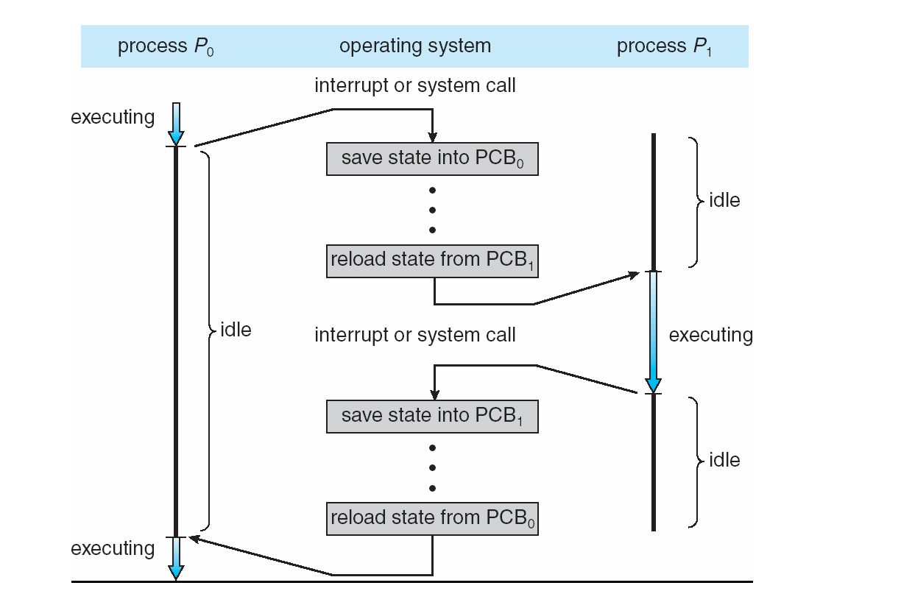
Context Switch

Slide 8
Process Life Cycle
As a process executes, it changes state
new: The process is being created
running: Instructions are being executed
waiting: The process is waiting for some event to occur
ready: The process is waiting to be assigned to a process
terminated: The process has finished execution

Slide 9
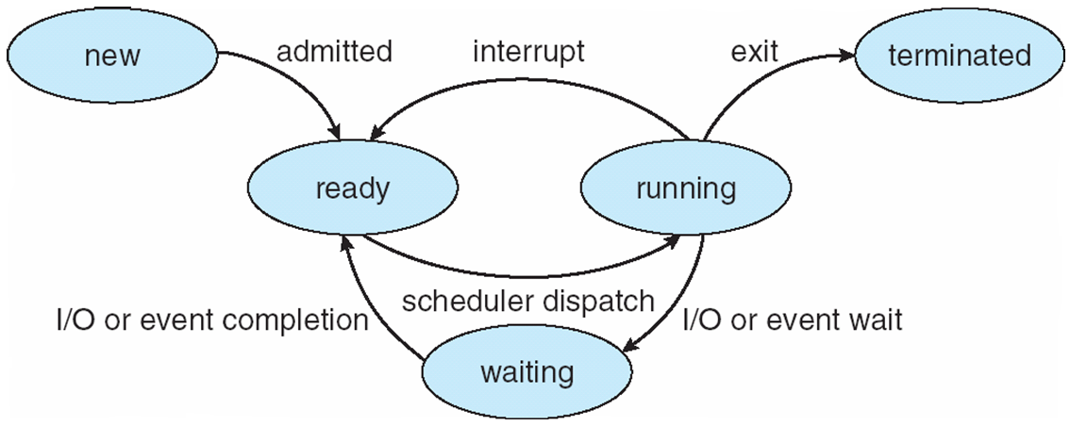
Process Life Cycle

Slide 10
Process Life Cycle
Assume that process is running with a Unix operating system with no user process
Various events in life of processes within a multiprogramming system are given below;
User using the shell command interpreter, types in a program name, say solvit
The shell finds this program and program code will be loaded
A system call will be used to generate a process corresponding to the execution of the solvit program
The OS creates process control block in the memory
The process solvit will now begin to run – the process is said to be in running state
After a while, solvit needs to read some data from a disk file and issue an appropriate system call
The process is now said to be in the blocked state

Slide 11
Process Life Cycle
In the meantime, another user wants to run a program called myprog
A new process is created for myprog and since solvit is currently idle, execution begins; myprog is now running
The I/O delay which is blocking solvit now ends and solvit wants to restart; solvit is now said to be in ready state
The OS scheduler now decides that myprog has enough processor time (Timeout) and moves it into the ready queue
Solvit is restarted and enters the running state once more
Switching between active processes, waiting for I/O transfer etc. will continue for the life of the processes
Eventually, solvit completes its tasks and terminates; it leaves the running state and disappears from the system
Similarly, myprog terminates

Slide 12
Five State Process Model
Admit
Ready
Dispatch
Running
Release
Time-out
I/O Completion
I/O Request
Blocked
Resume
Suspended
Resume
Suspended
Suspended
Ready
Suspended
Admit
Blocked
Suspended

Slide 13
Five State Process Model
There are two queues; a ready queue and a blocked queue
OS chooses a process the ready queue to run
In the absence of any priority scheme, this can be a simple FIFO
A running process is removed from execution, it is either
Terminated
Time quantum is over
Performed I/O
After I/O completion processes in blocked queue are moved to ready queue
When an event occurs, the OS must scan the entire blocked queue
In a large OS, there could be hundreds or even thousands of processes in that queue
It would be more efficient to have a number of queues, one for each event
When an event occurs, the entire list of processes in the appropriate queue can be moved to the ready state

Slide 14
Five State Process Model
Consider a system that does not employ virtual memory
Each process to be executed must be loaded fully into memory
In multiple blocked queuing model, all the processes in all the queues must be resident in memory
Memory holds multiple processes
Solutions
Expand the memory
it has own flaw
Cost associated with expansion
Swapping
Moving part or all of a process (blocked) from memory to disk (suspended queue)
The space that is freed up in memory can be then be used to bring another process
When a process is suspended, it becomes dormant and merely waits until it is resumed by the system or user

Slide 15
Five State Process Model
A process can be suspended for the following reasons;
Process being swapped put of the memory by the memory management system in order to free memory for higher priority processes
A user may wish to suspend execution of a program for purpose of debugging a program
Process investigates previous effects of the process
Processes designed to run periodically to monitor system usage
The OS may suspend a background or utility process or a process that is suspected of causing a problem
The process can be suspended while in running, ready or blocked state

